Slide 1
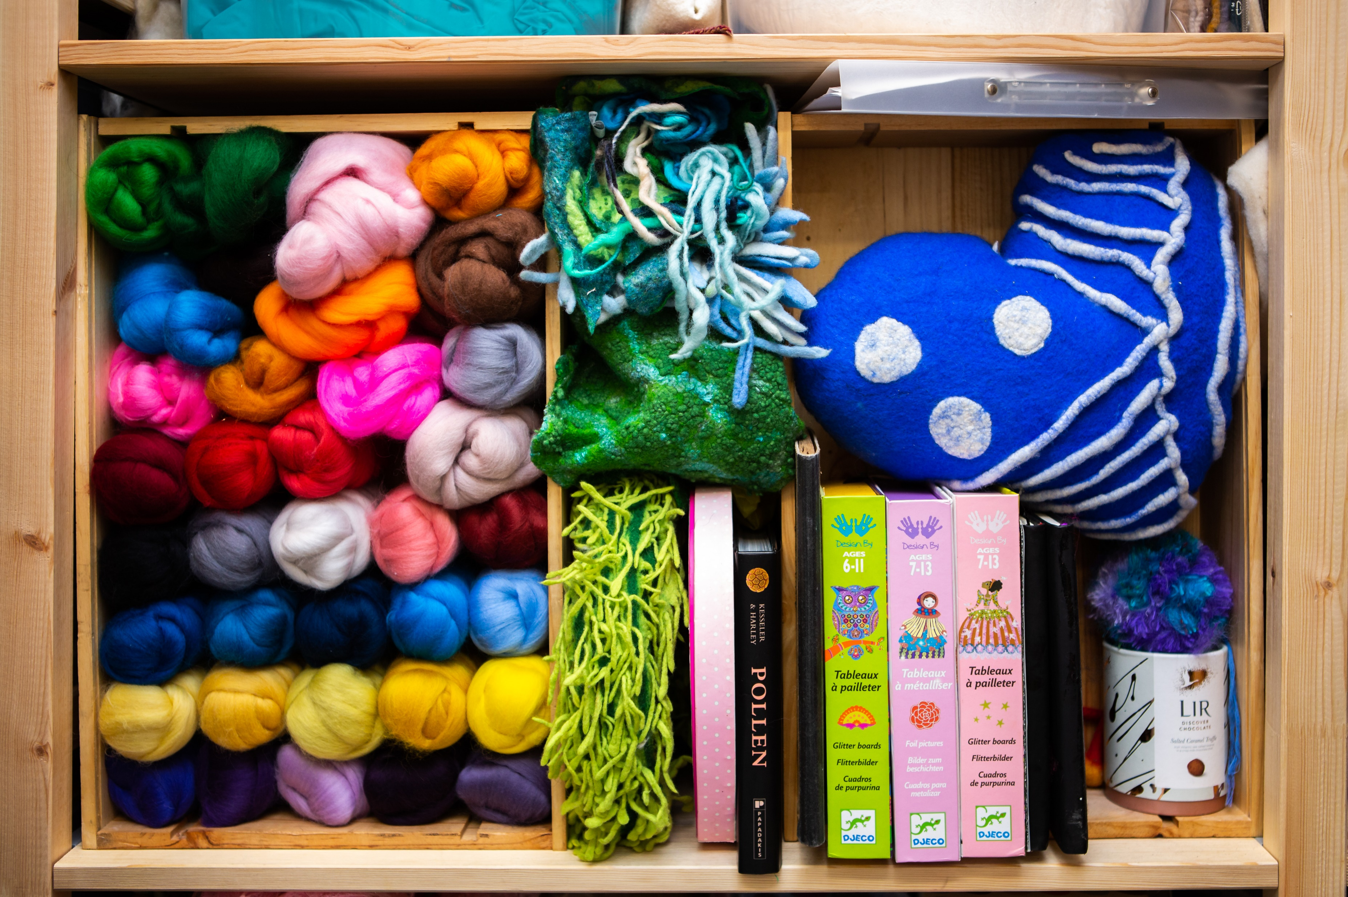
Textiles Journey Festival 2022

Slide 2
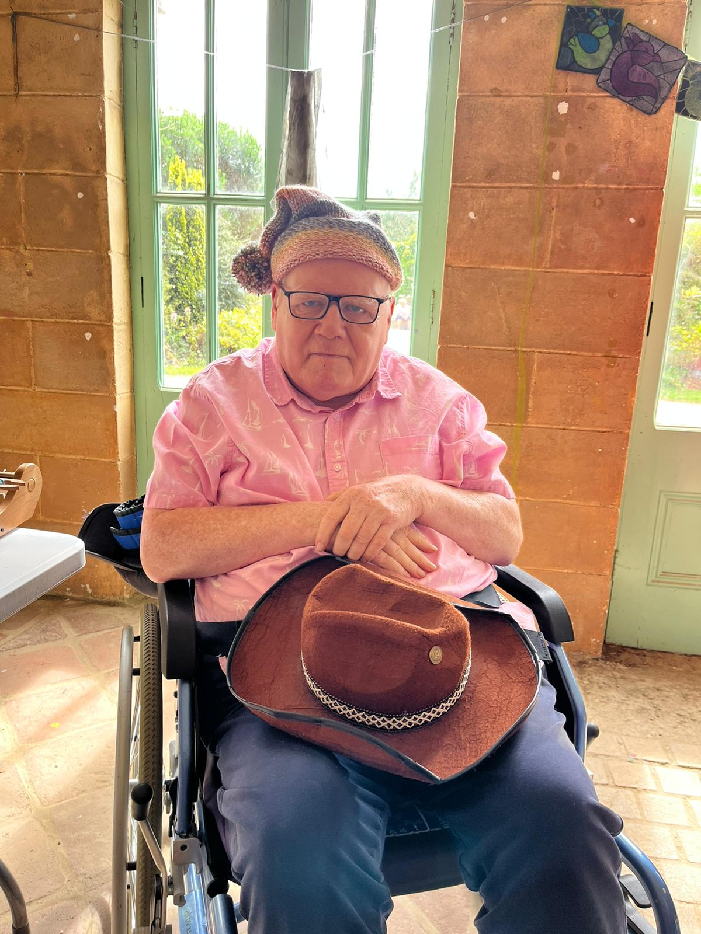
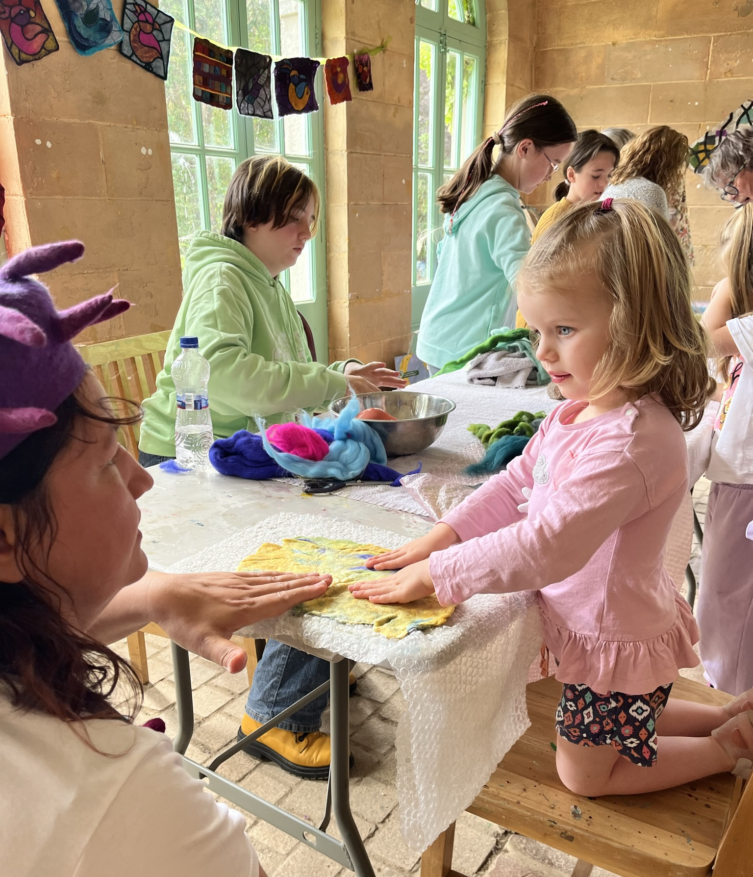
Explore, Create, Connect

Slide 4
Events, Days, Achievements
Summer Camp
Open Studio
Demonstrations
Film Screening

Slide 5
Demos 1st - 5th August
Day 5 Embroidery
Day 3
Felting
Day 4 Interactive
Day 1 Knitting
Day 2 Weaving

Slide 6
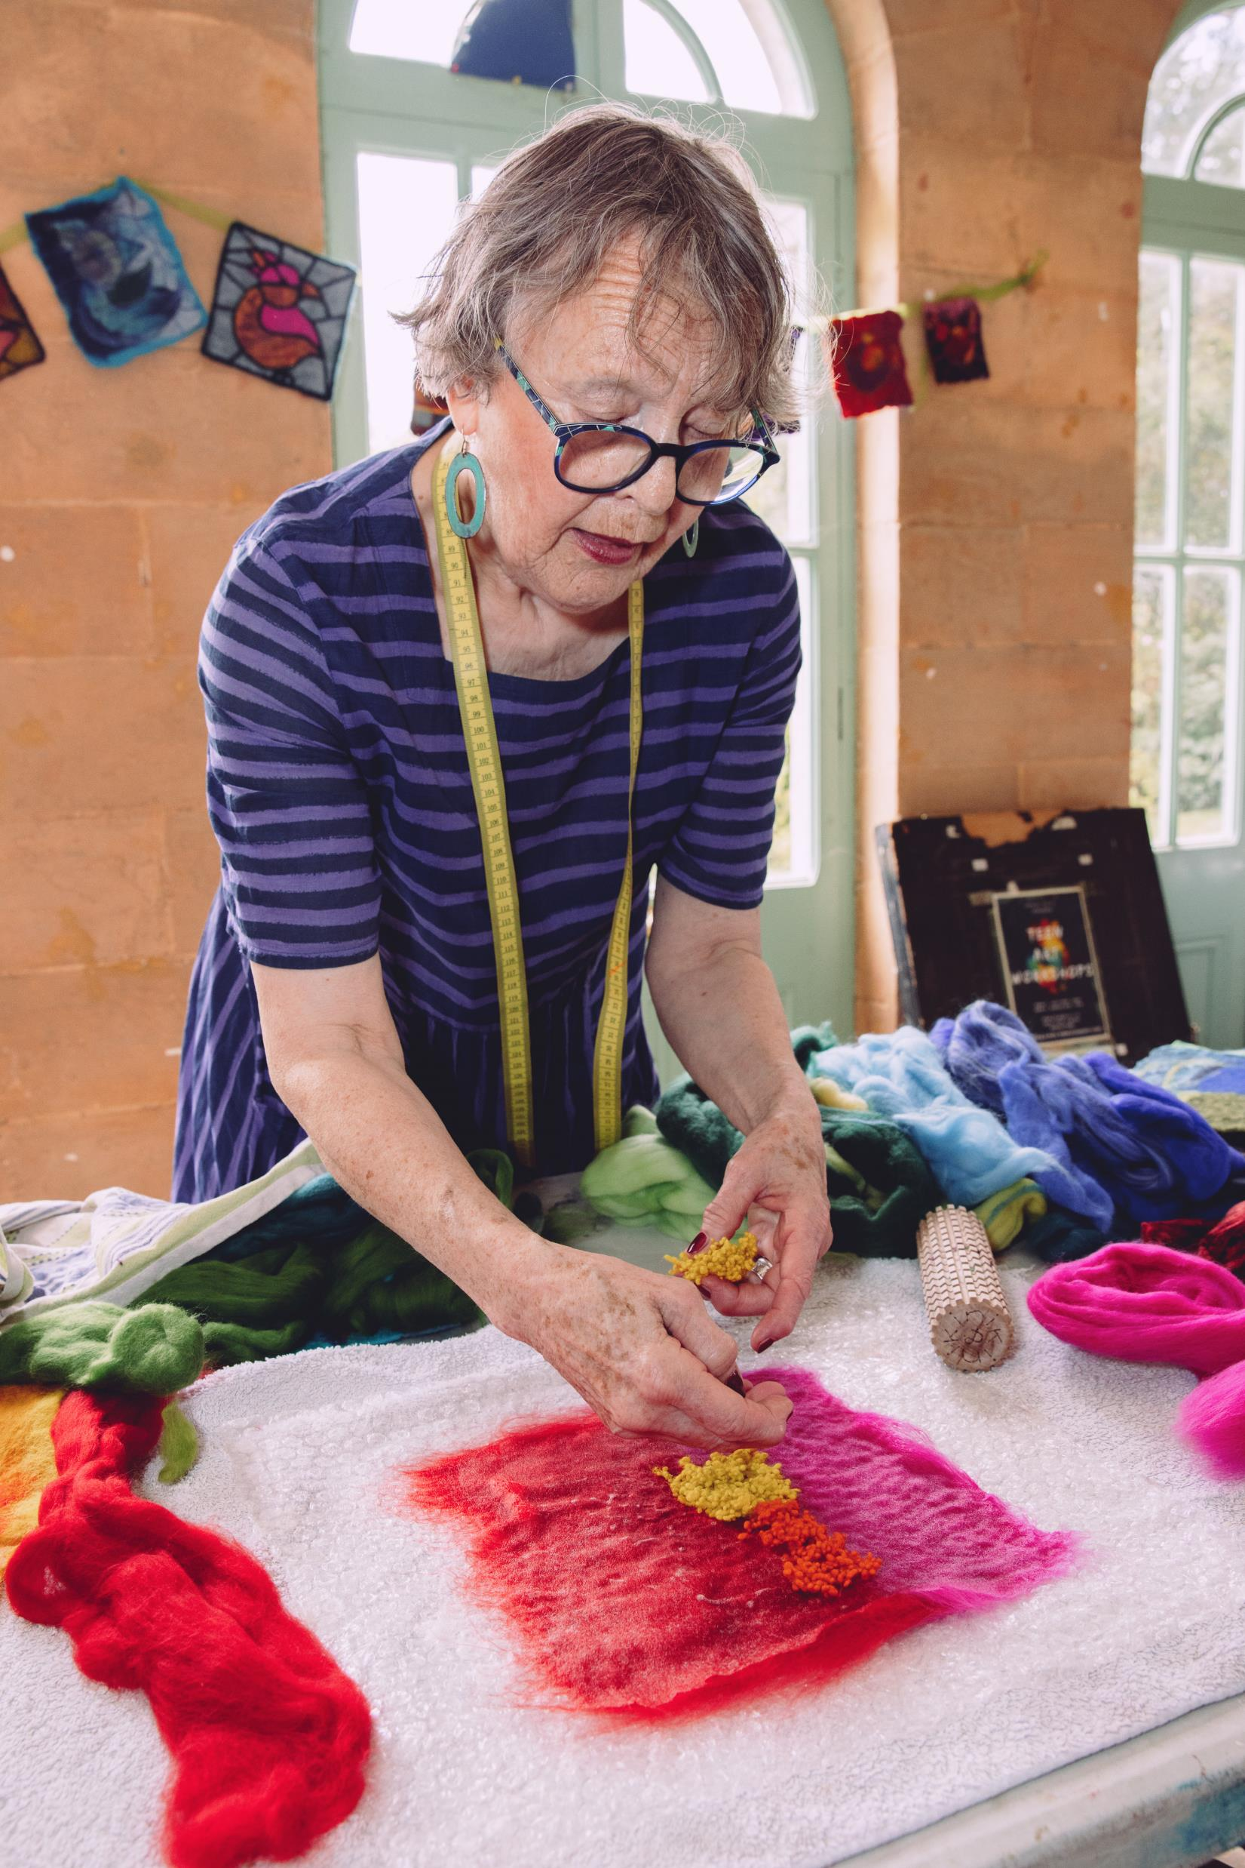
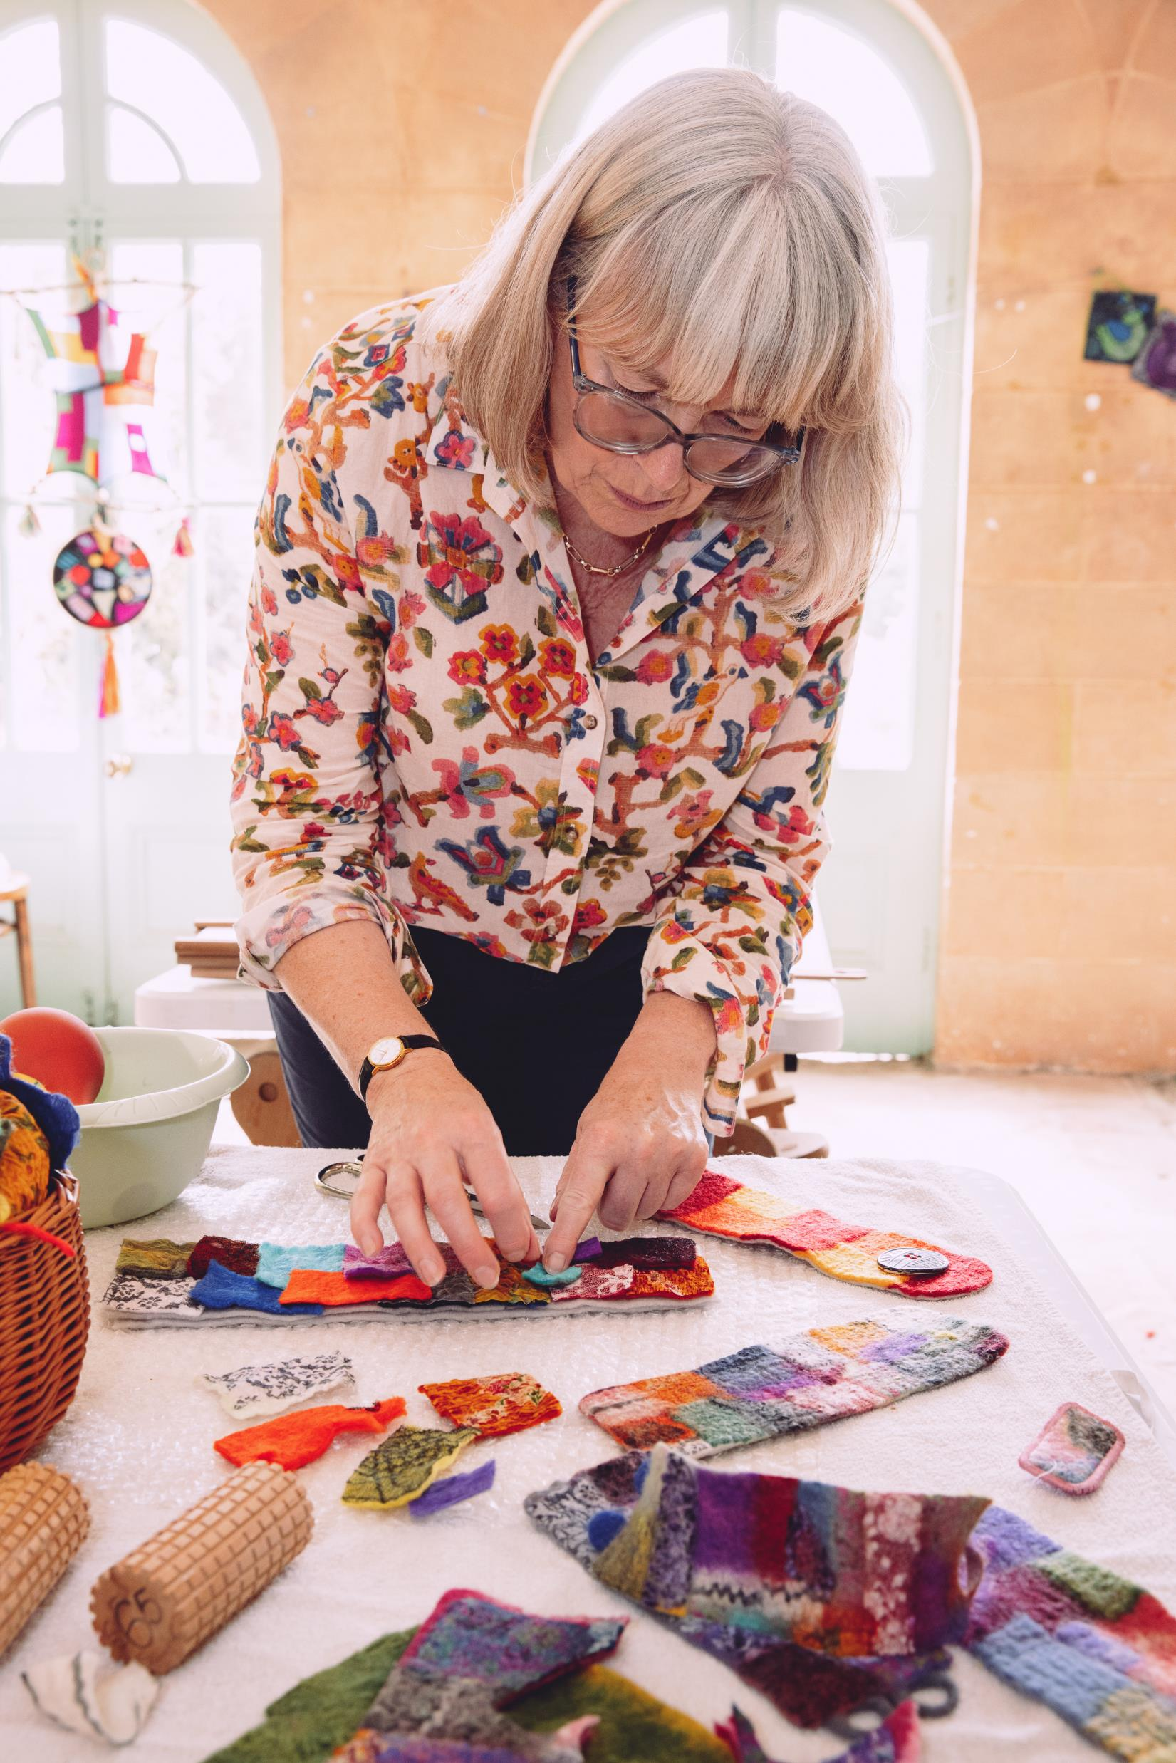
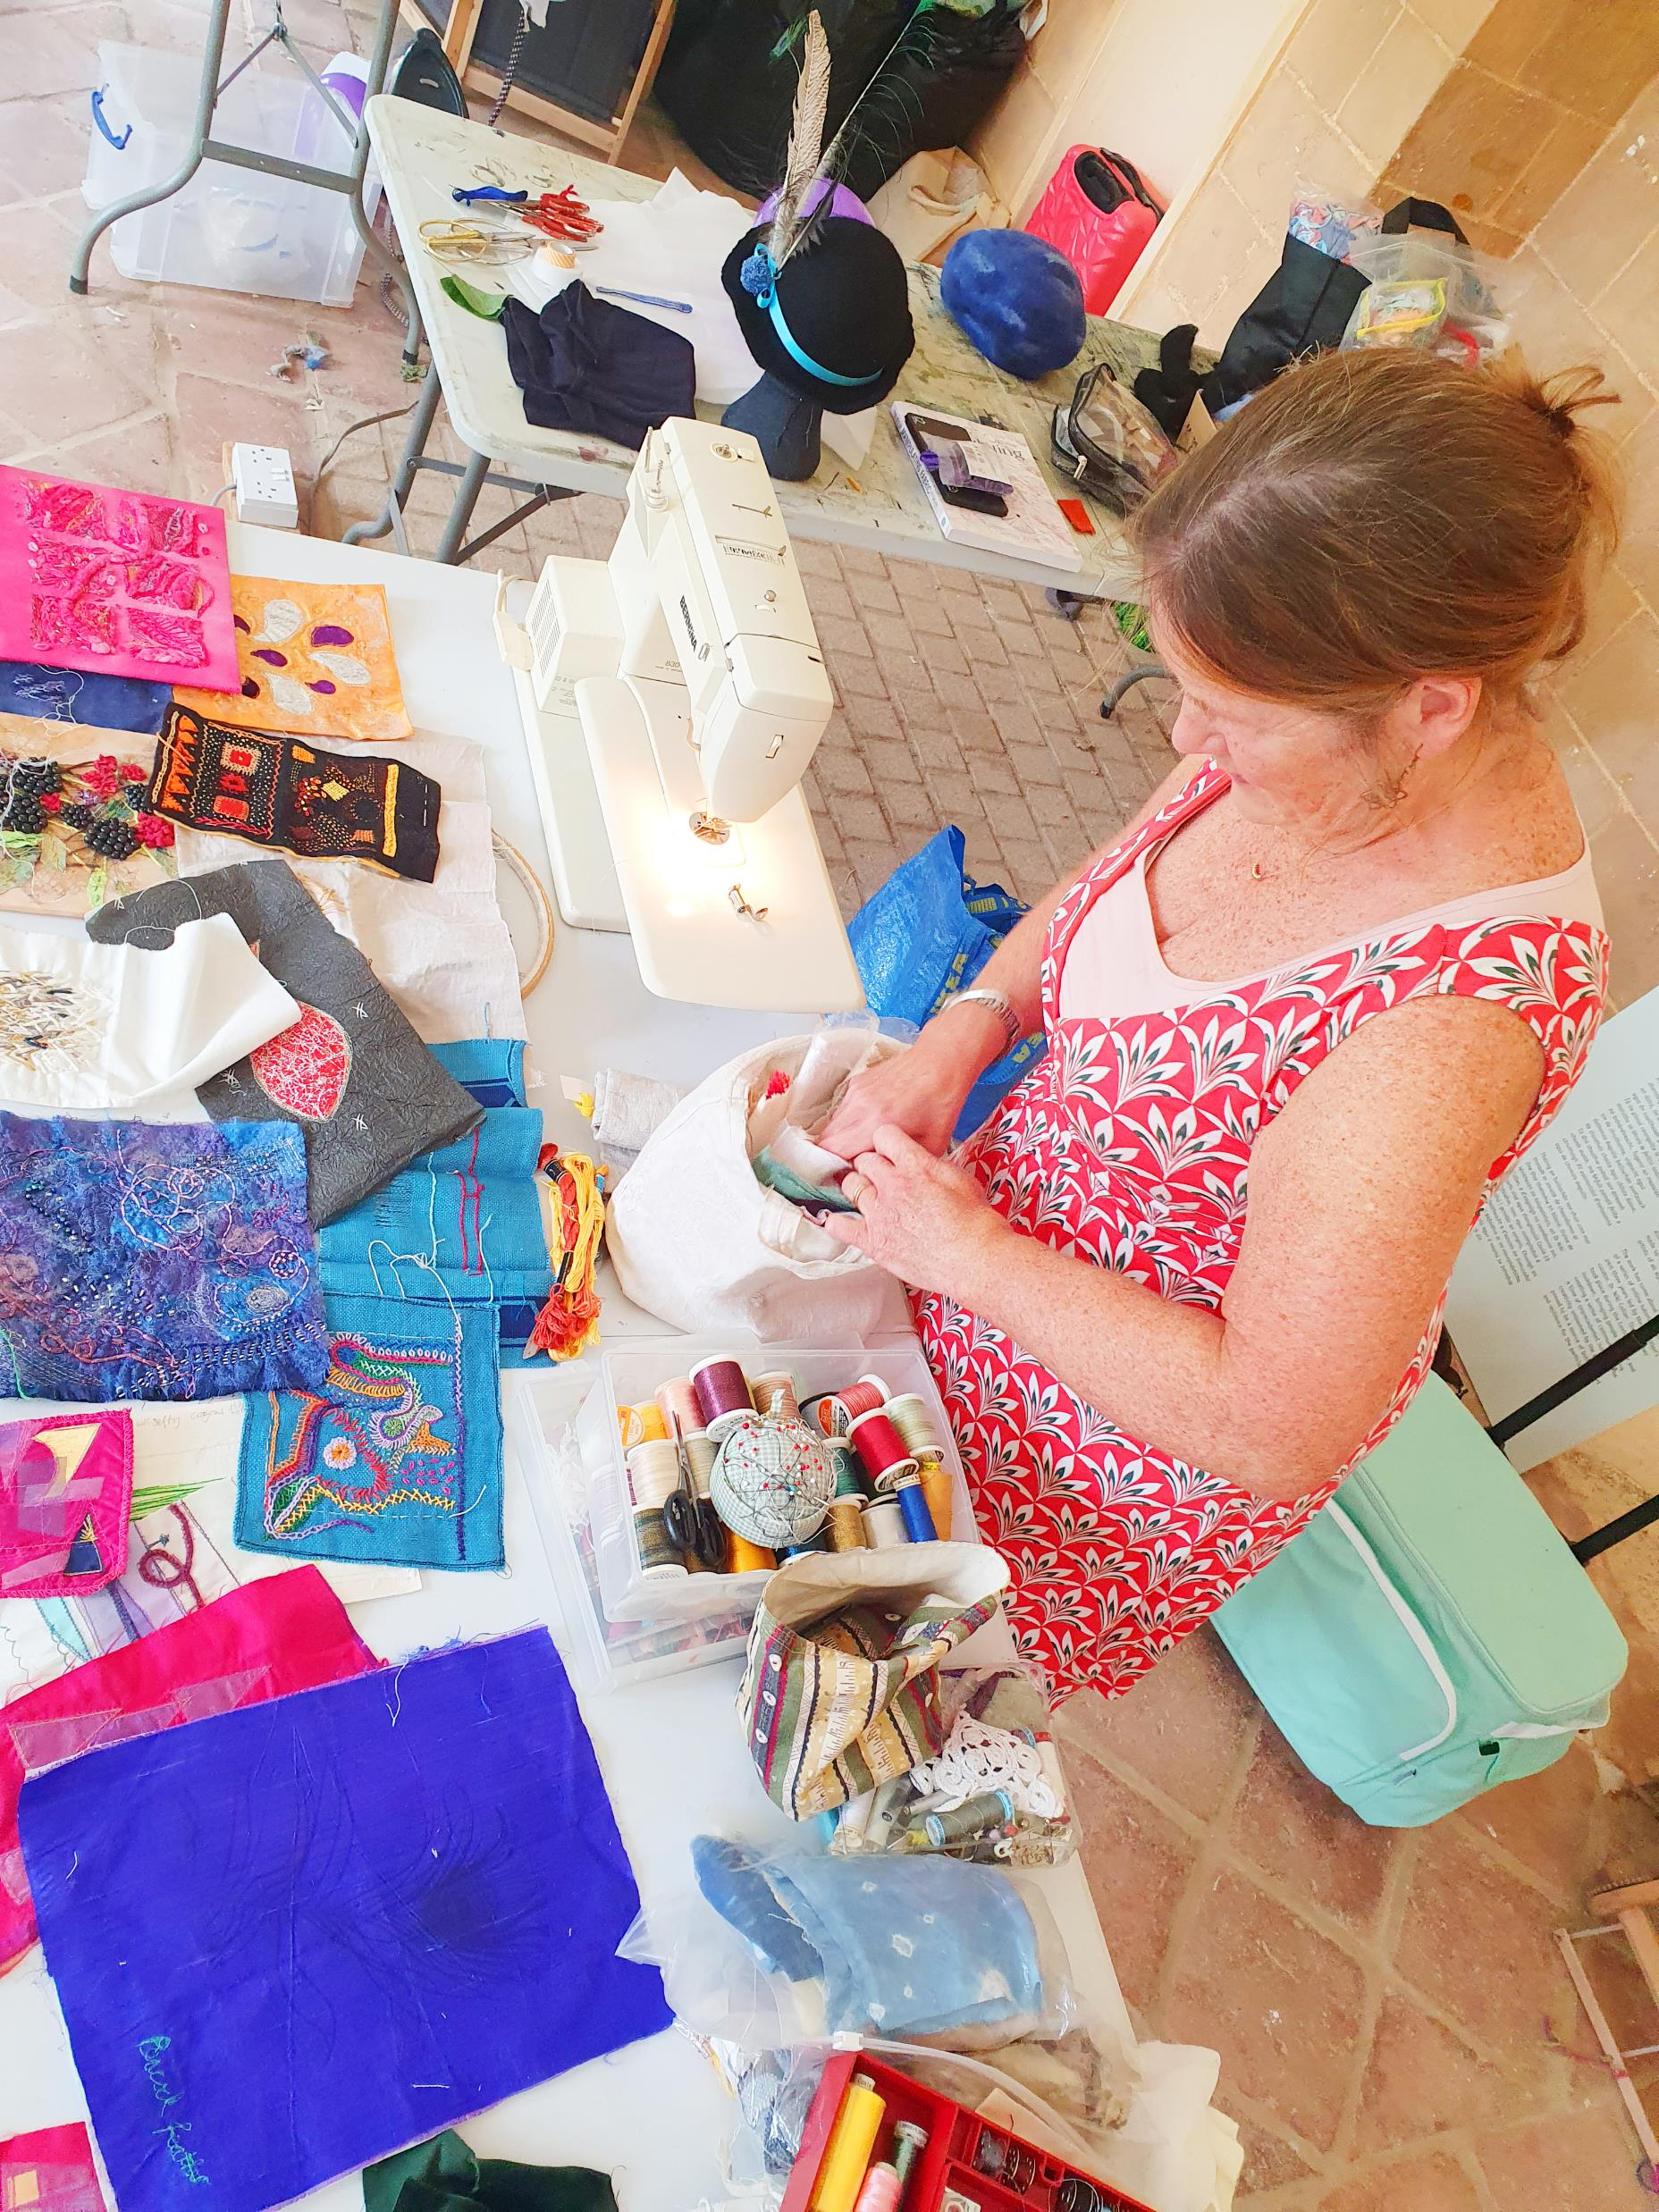
Textile Journey Festival Tutors: Astrid Helene Cosima Eithne

Slide 7
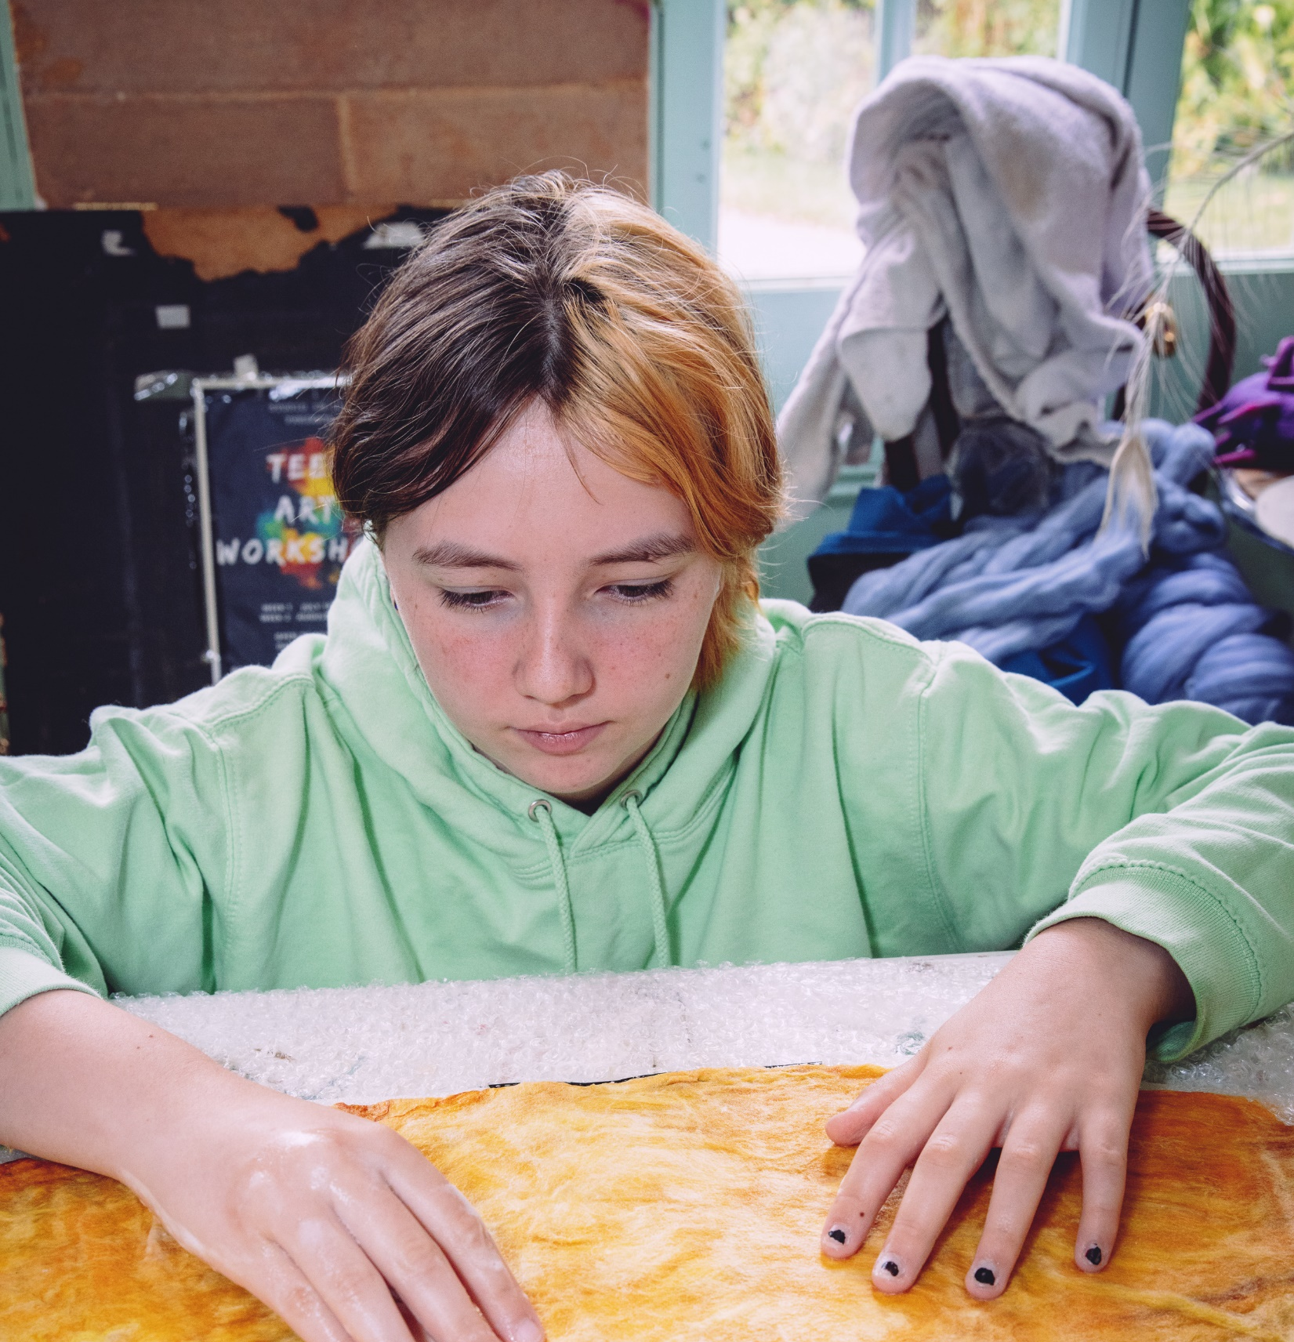
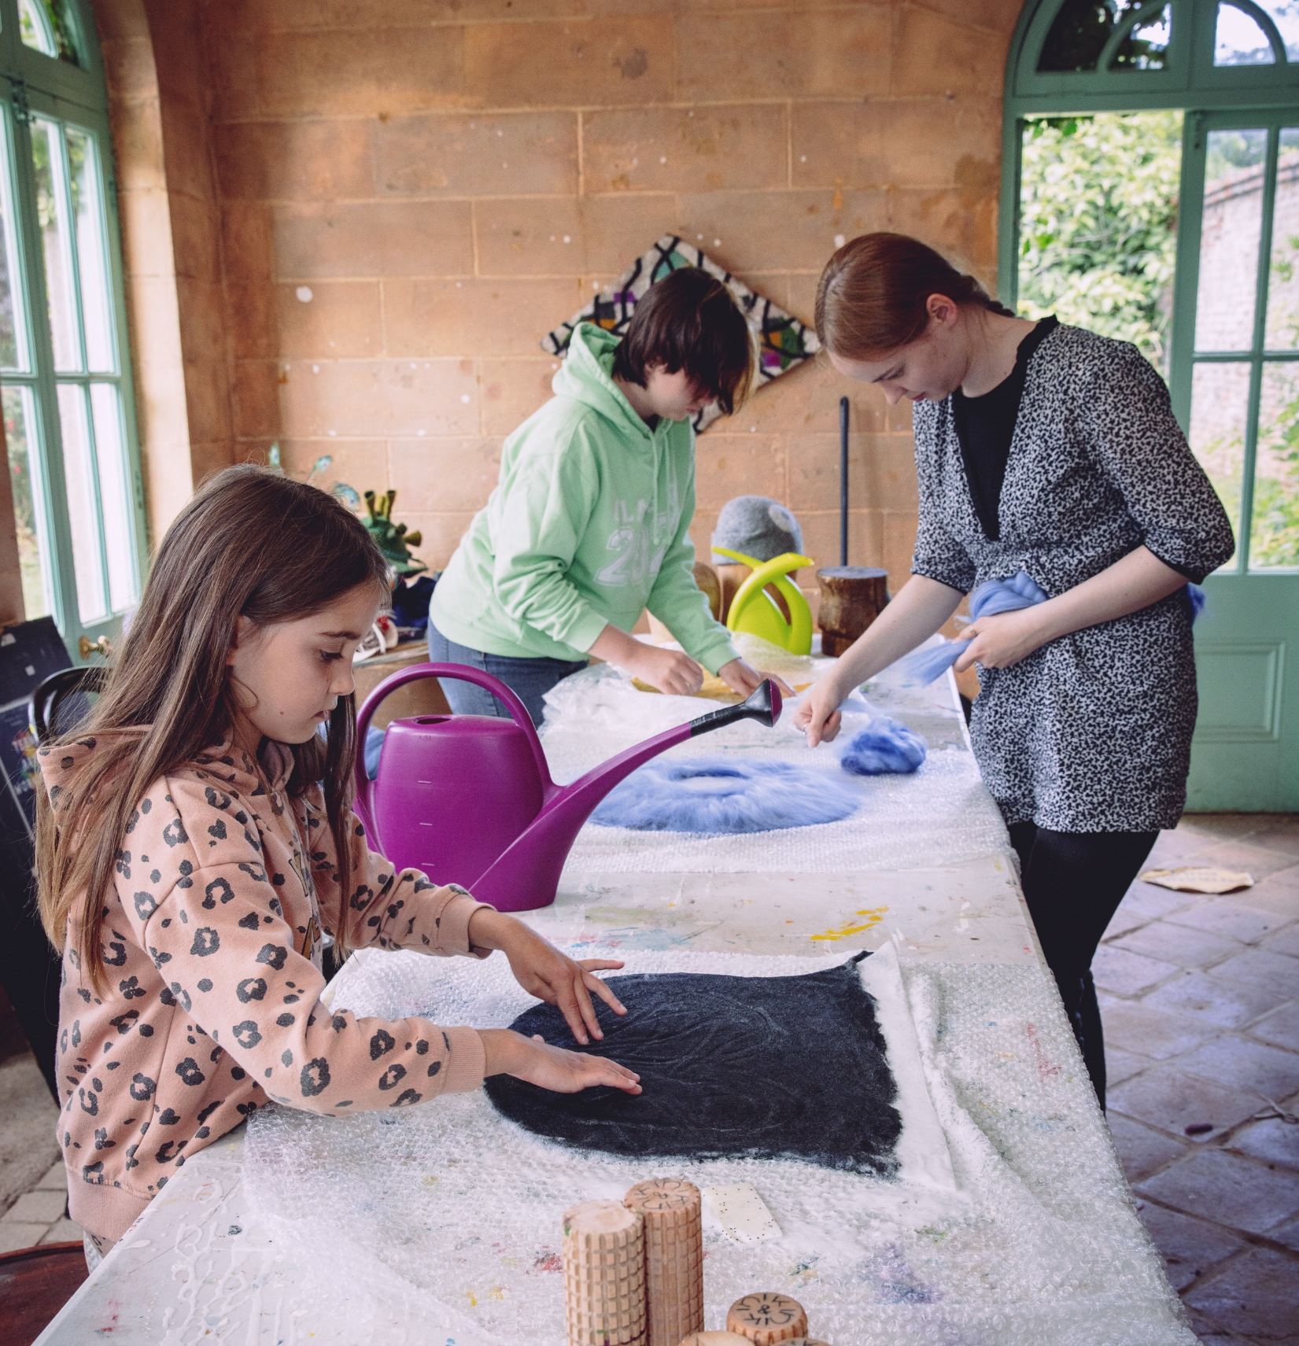
Summer Camp

Slide 8
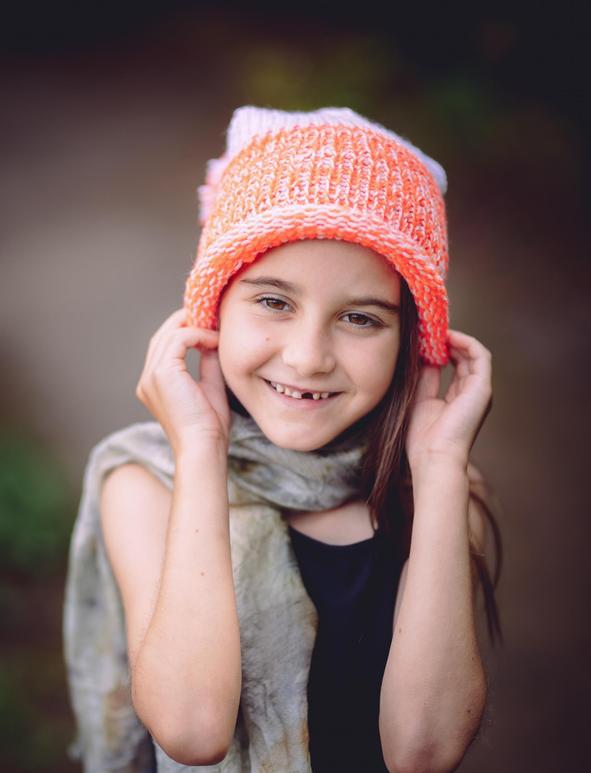
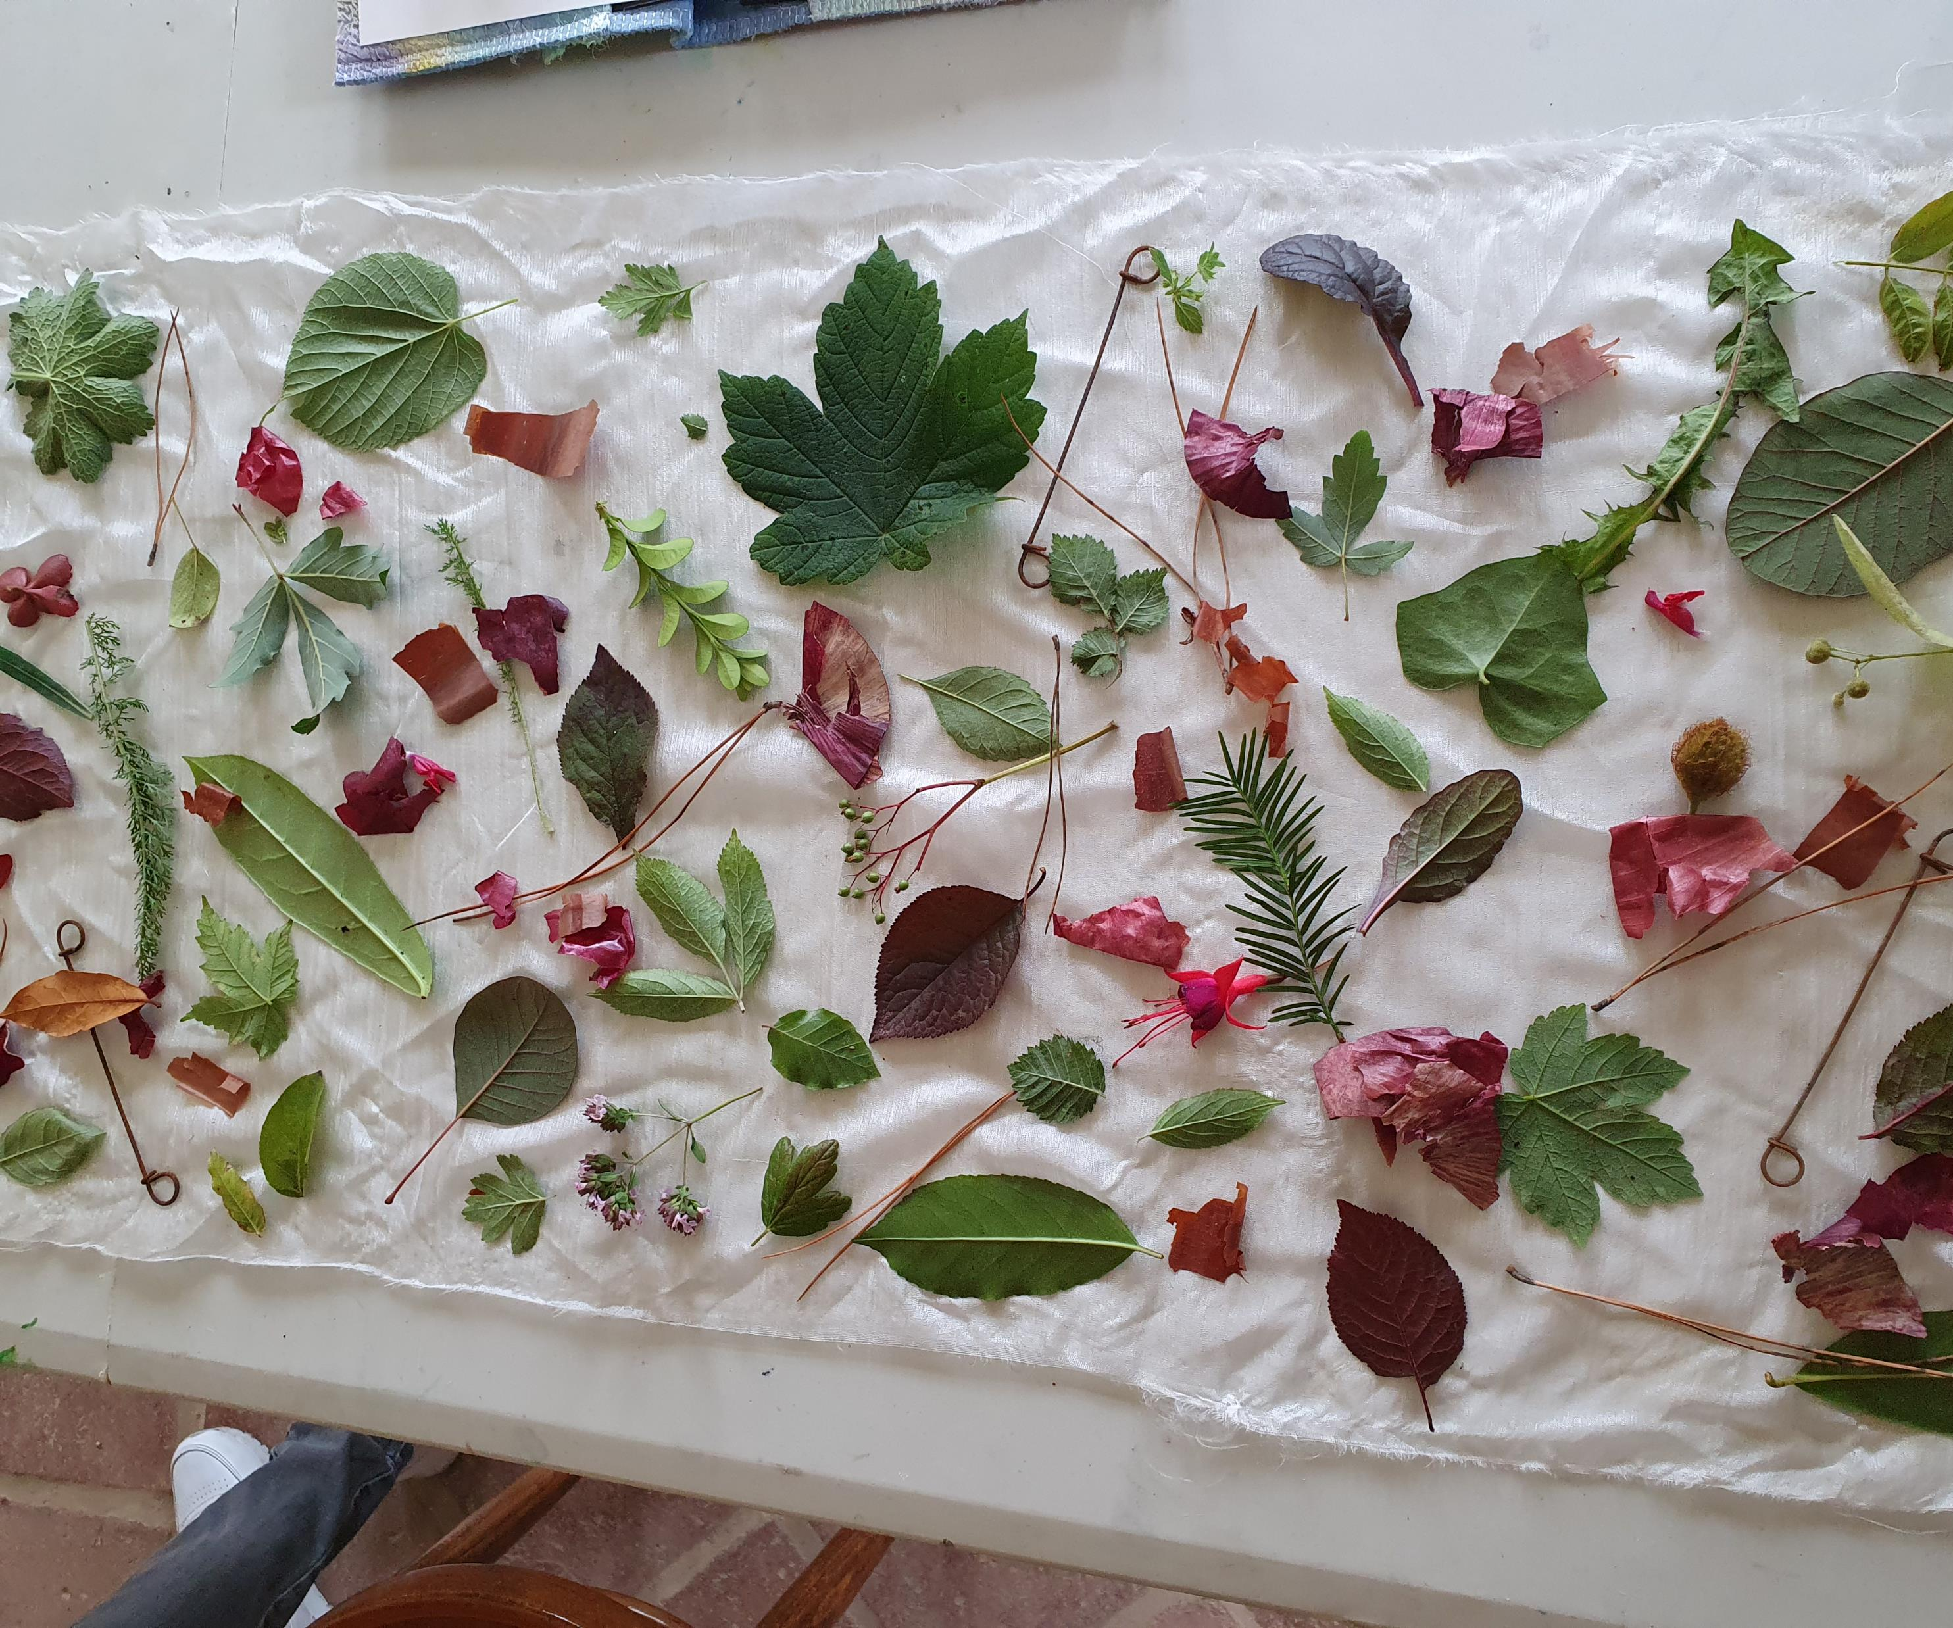
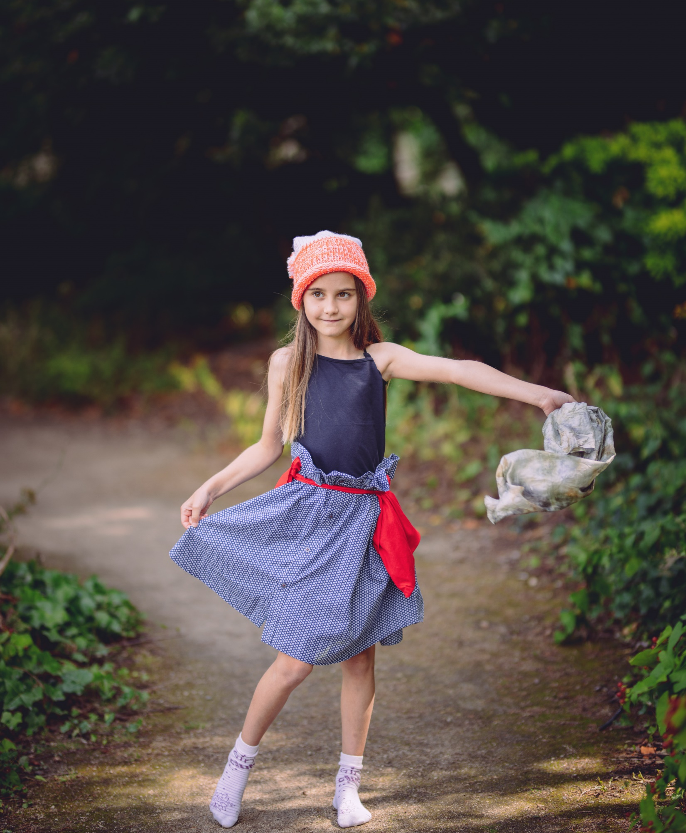
Summer Camp : Polina

Slide 9
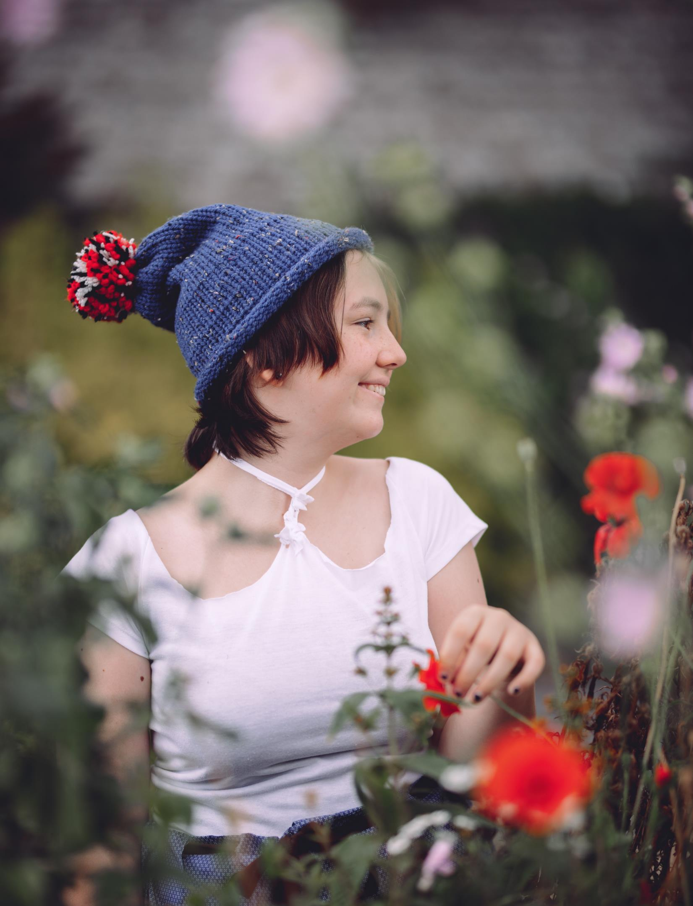
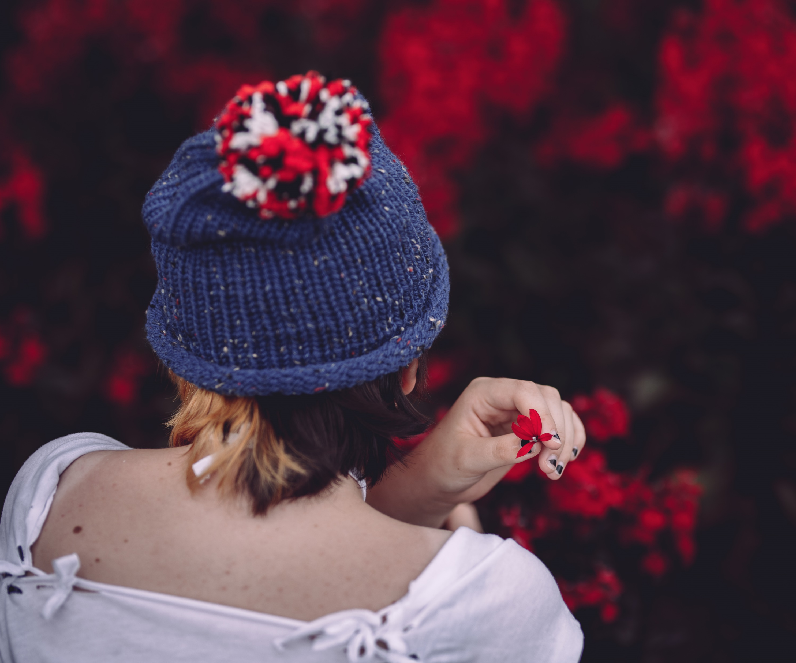
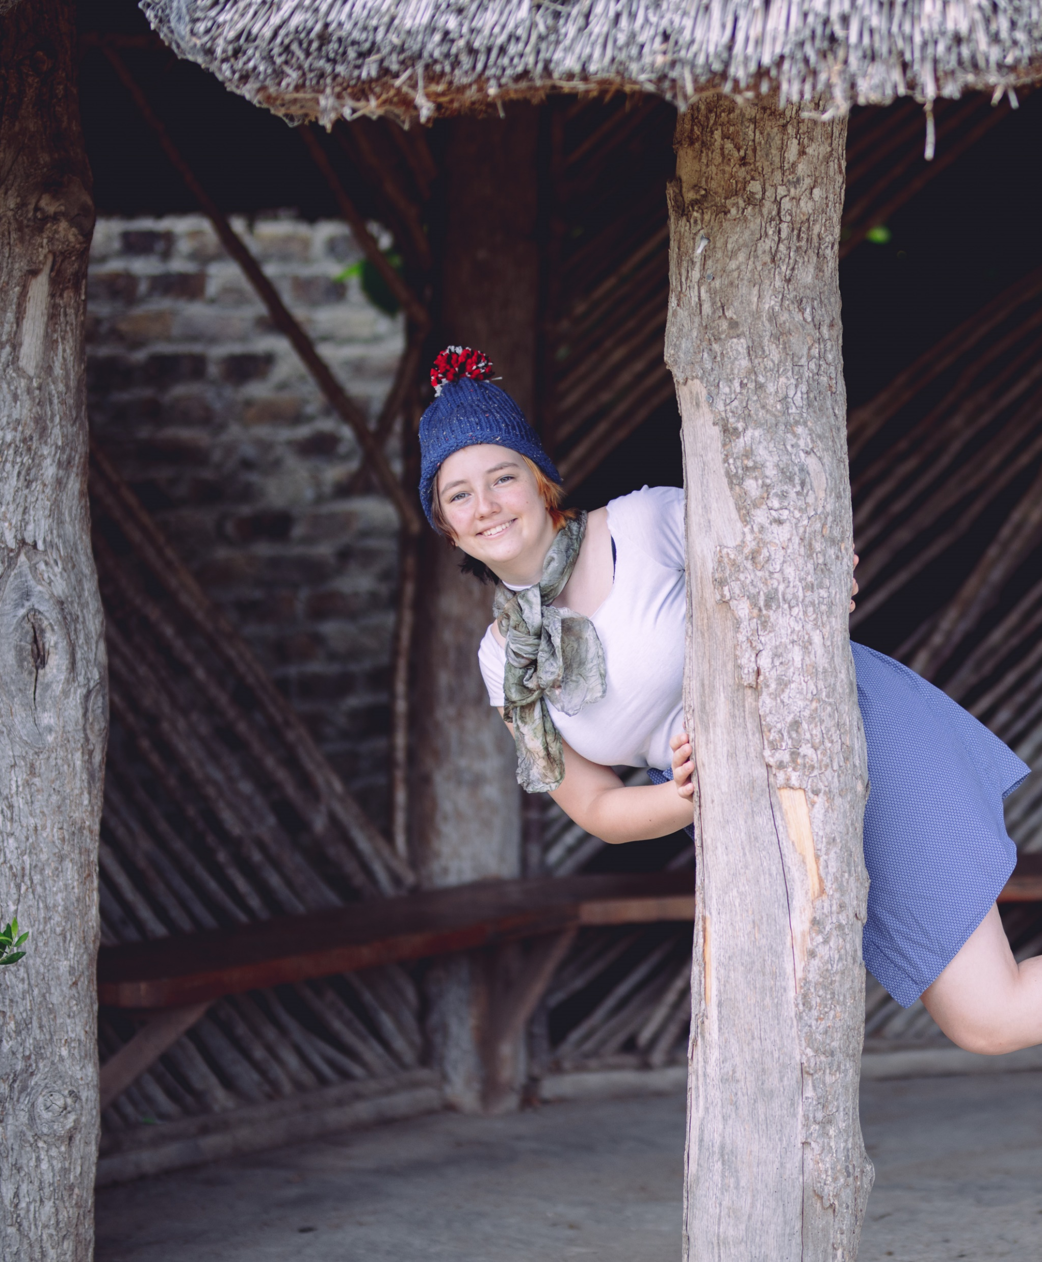
Summer Camp: Tanya

Slide 10
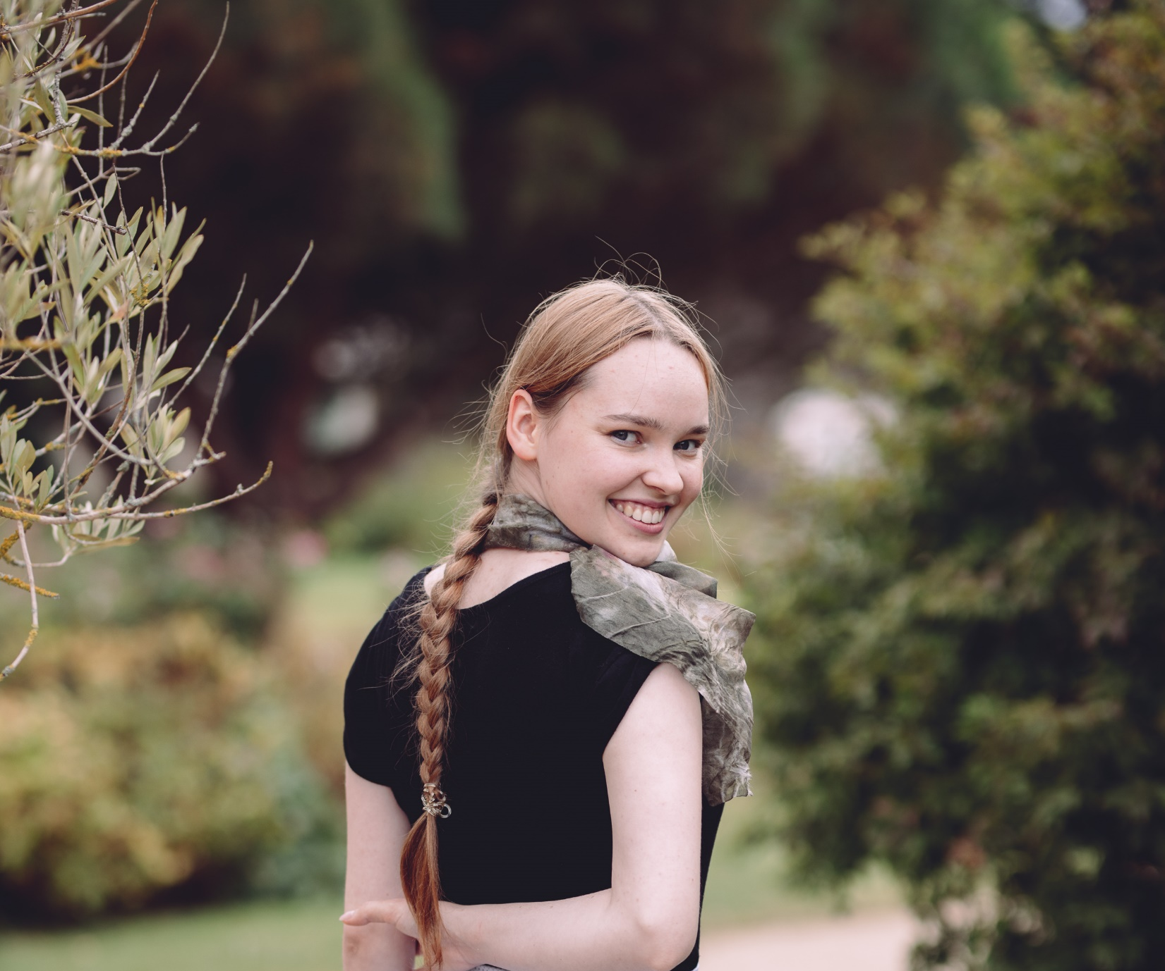
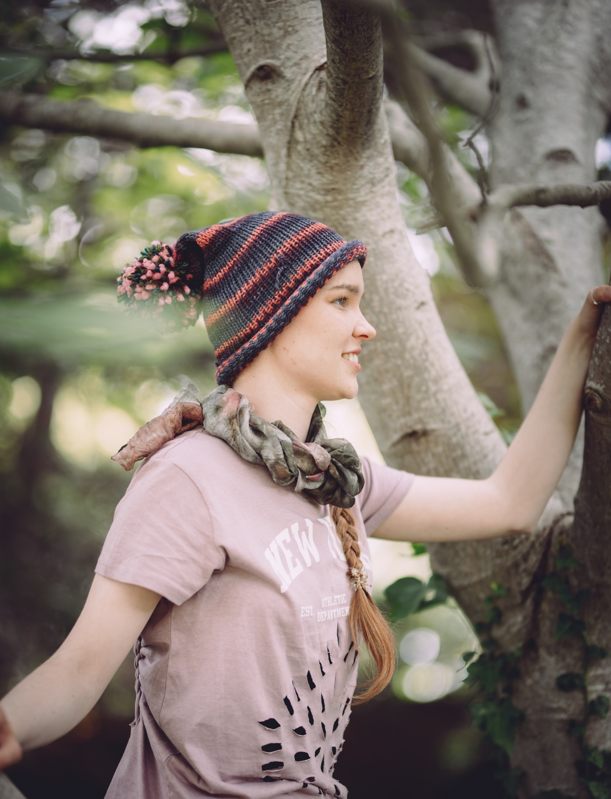
Summer Camp: Cosima

Slide 11
Thank you for the success of Textile Journey Festival!

Slide 13
Thank you to Helene! You were our rock! Thank you for driving, hosting, studio minding and the broom.

Slide 14
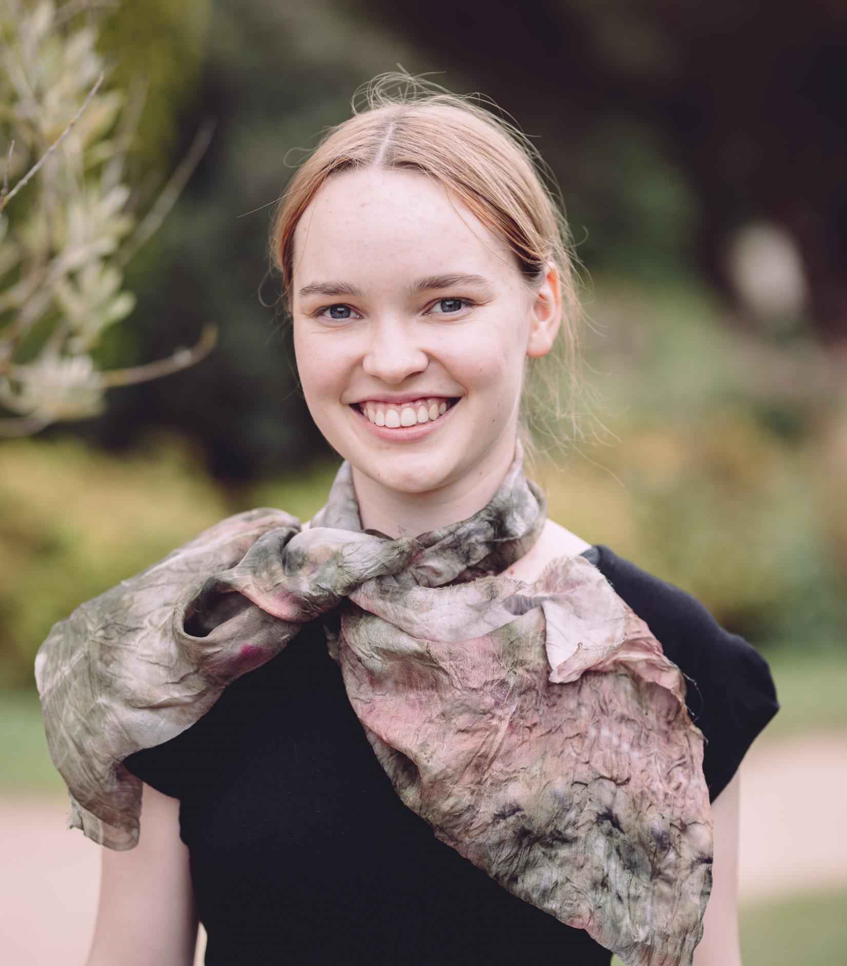
Thank you Cosima
It was a privilege to spend time for this kind and generous person.
Her humanity is credit to her.
The amazing talent and breath of skilla she showed is credit to her tutors . So education is still meaningful.

Slide 15
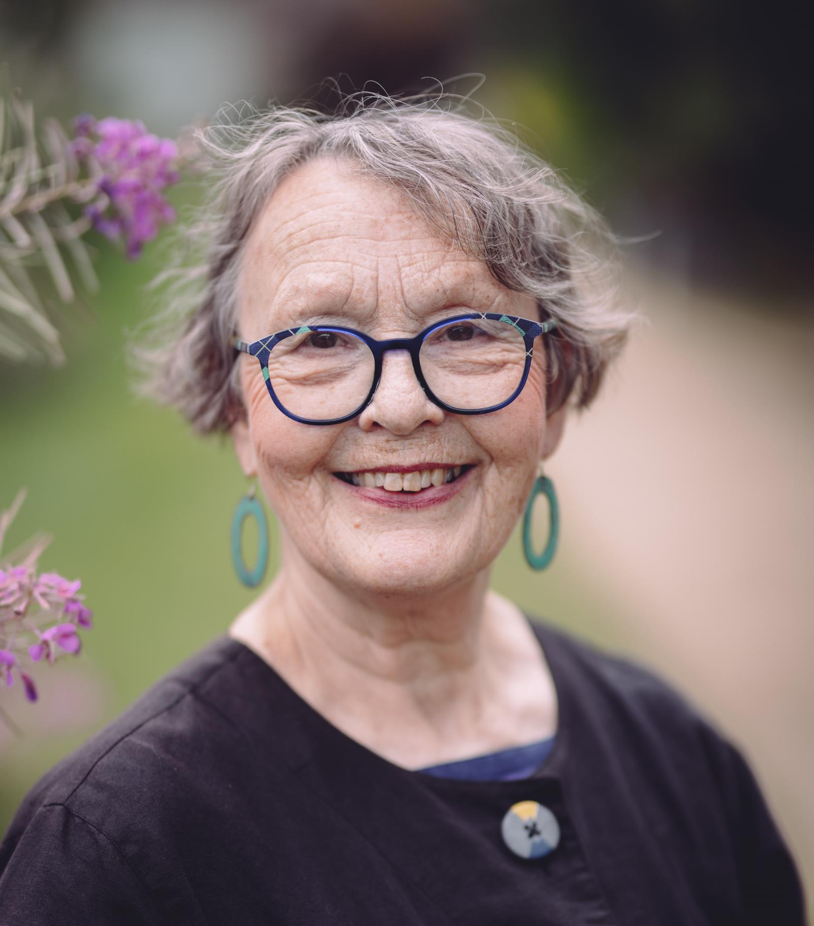
Thank you Astrid
For making inspiring demo and involving all of us!

Slide 16
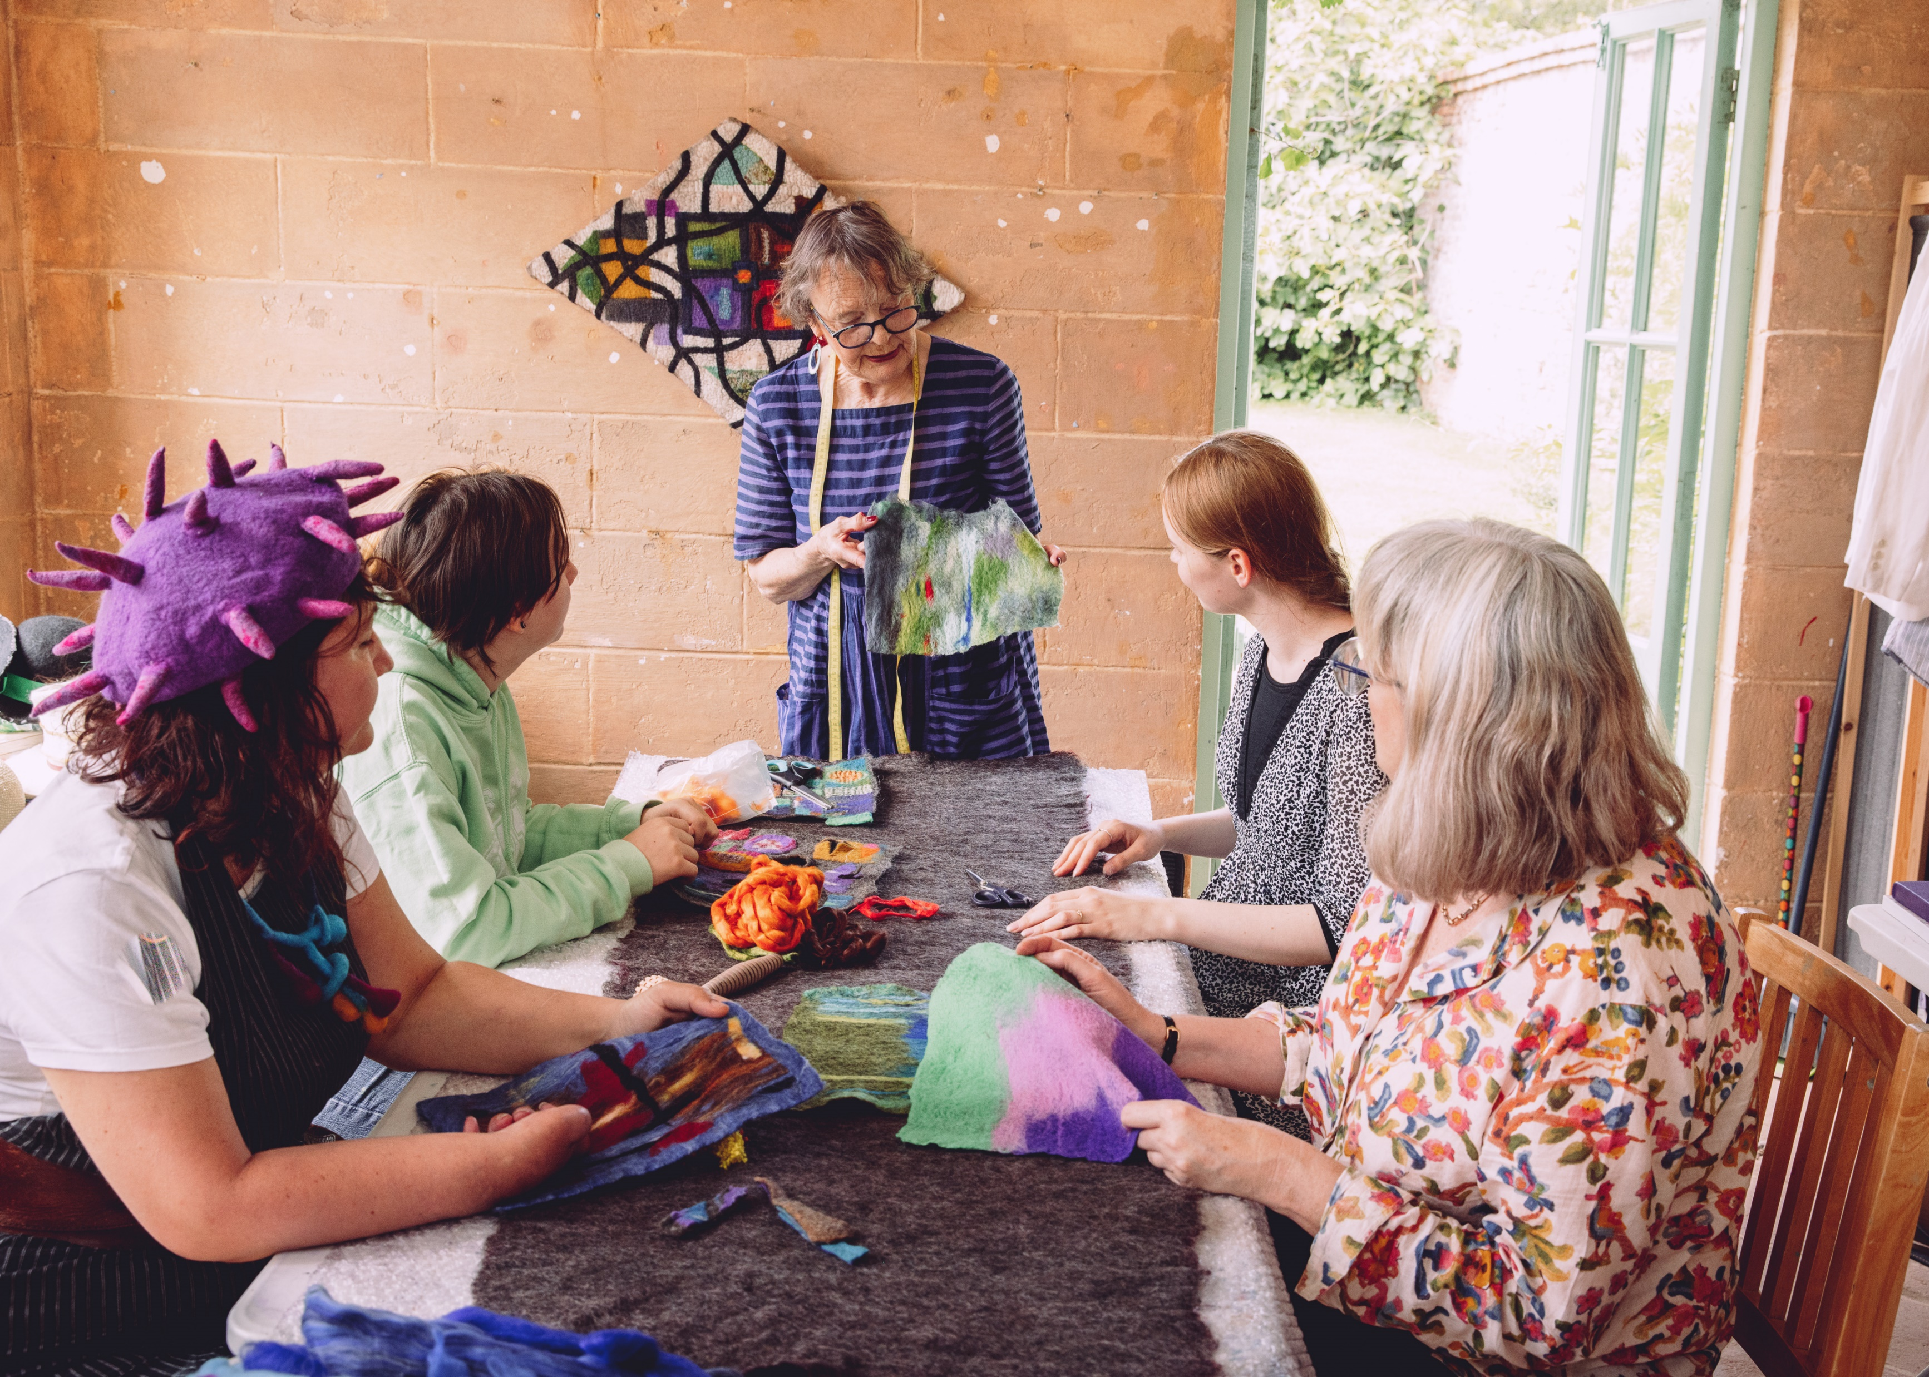

Slide 17
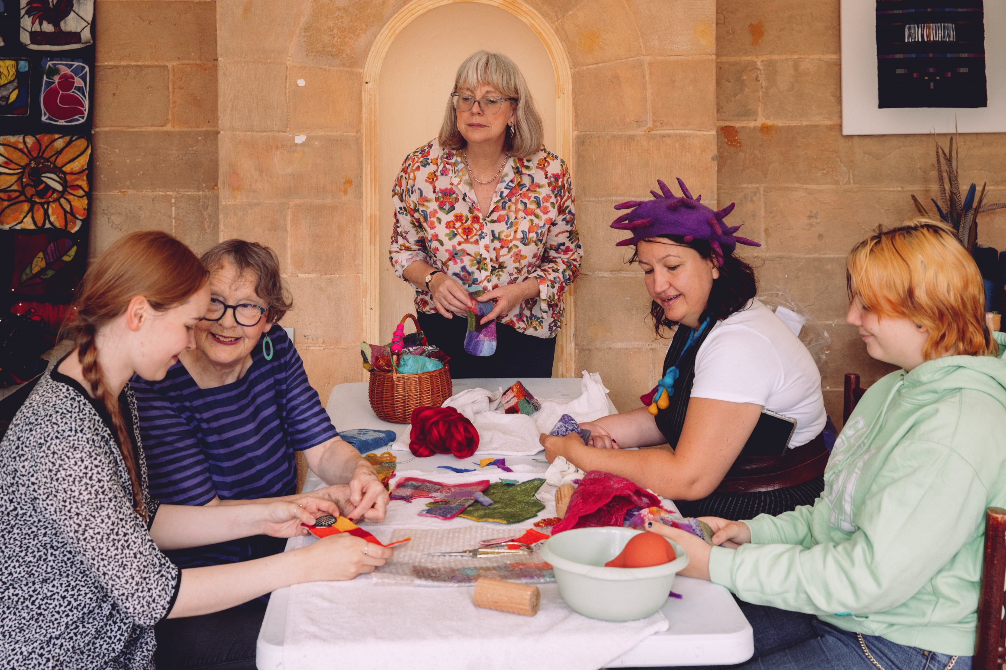

Slide 18
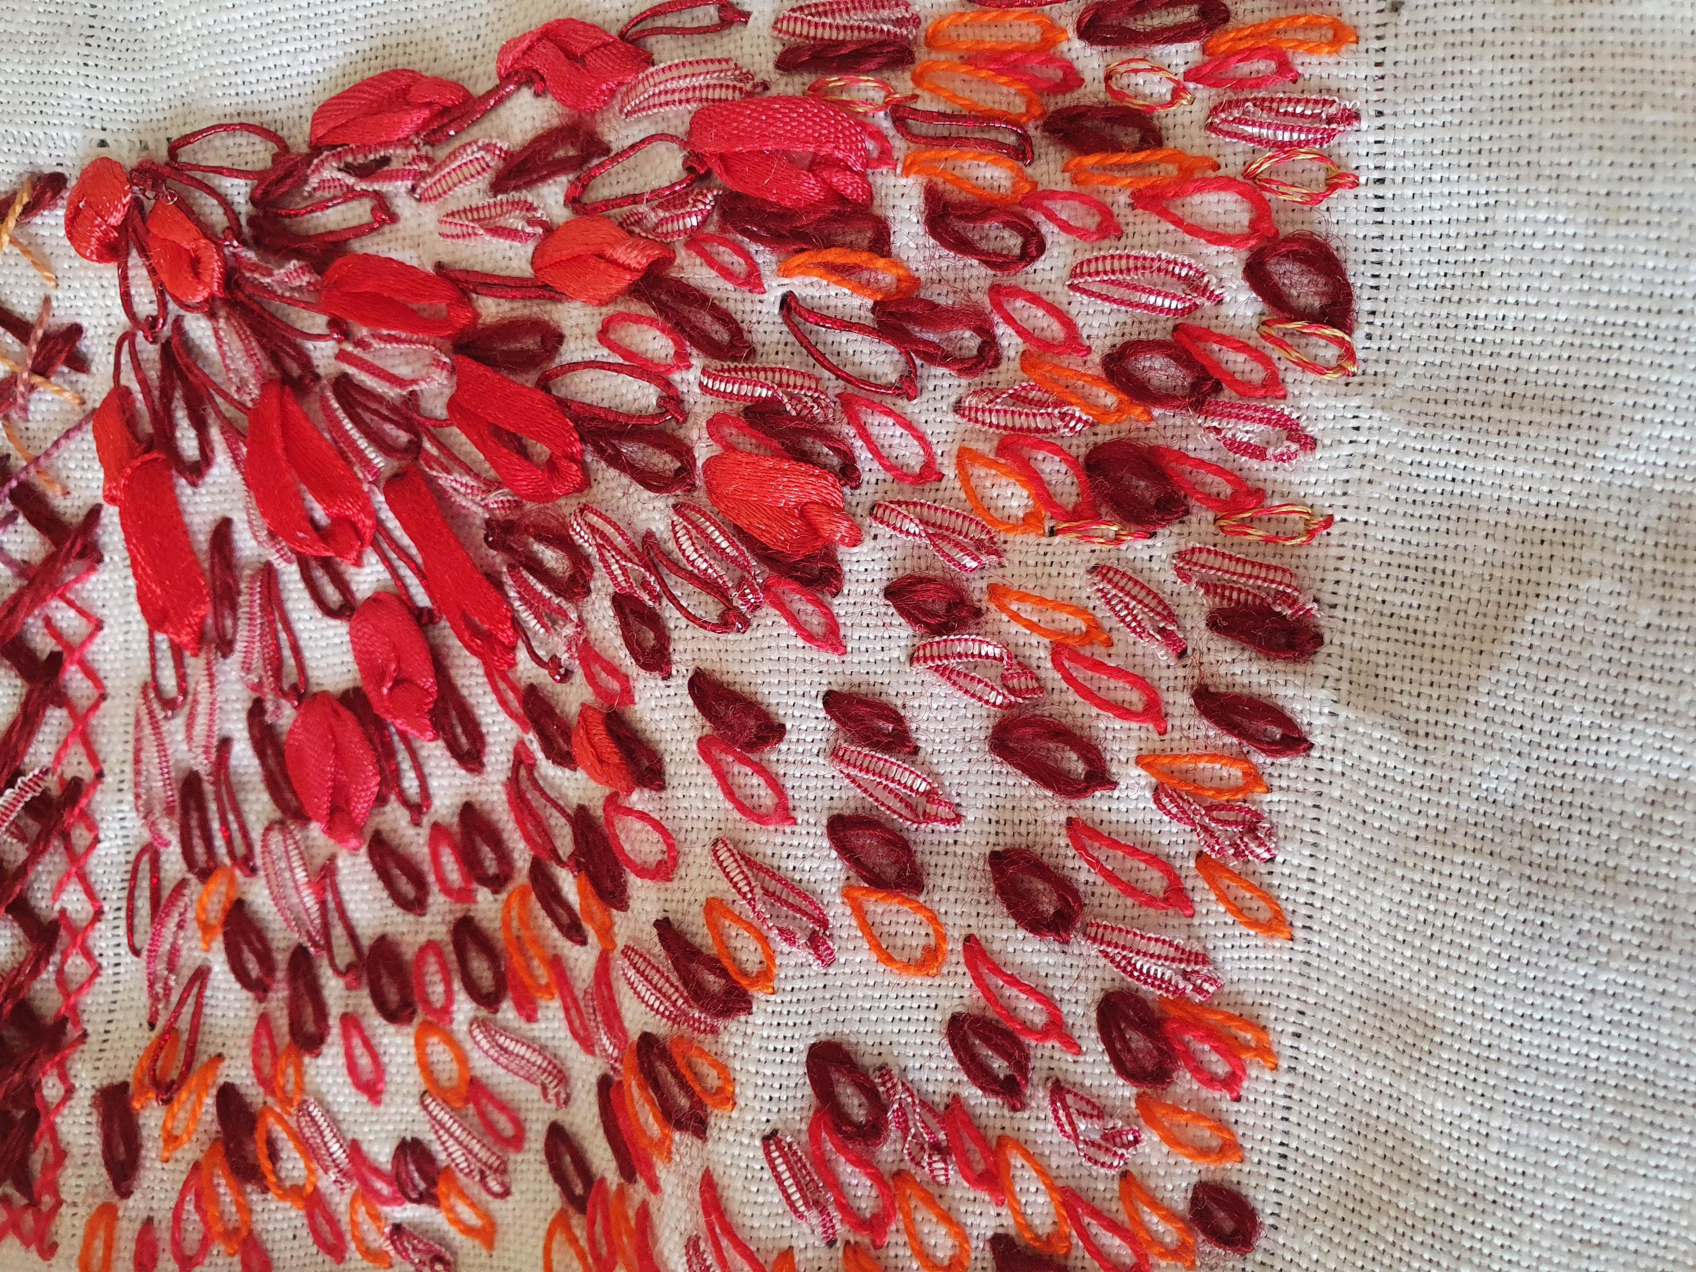
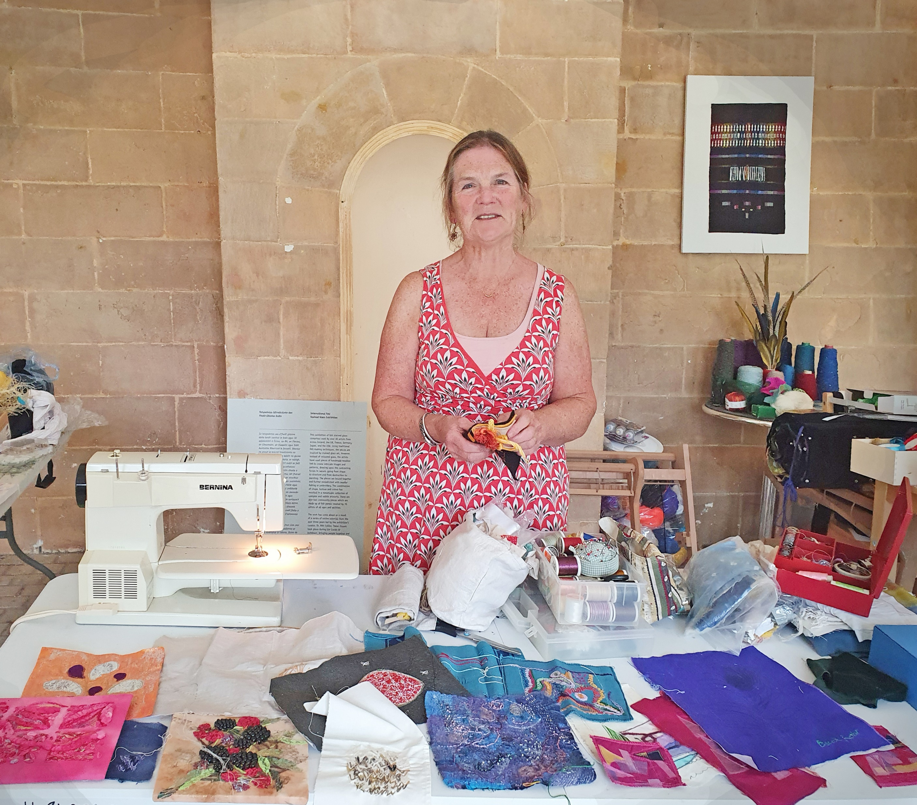

Slide 19
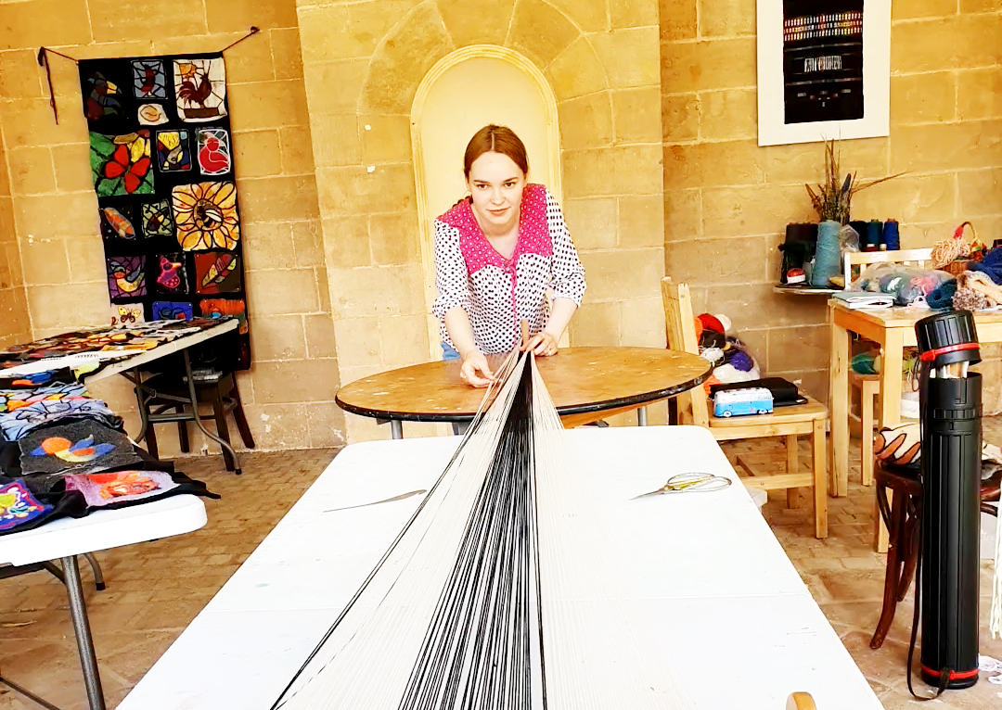

Slide 21
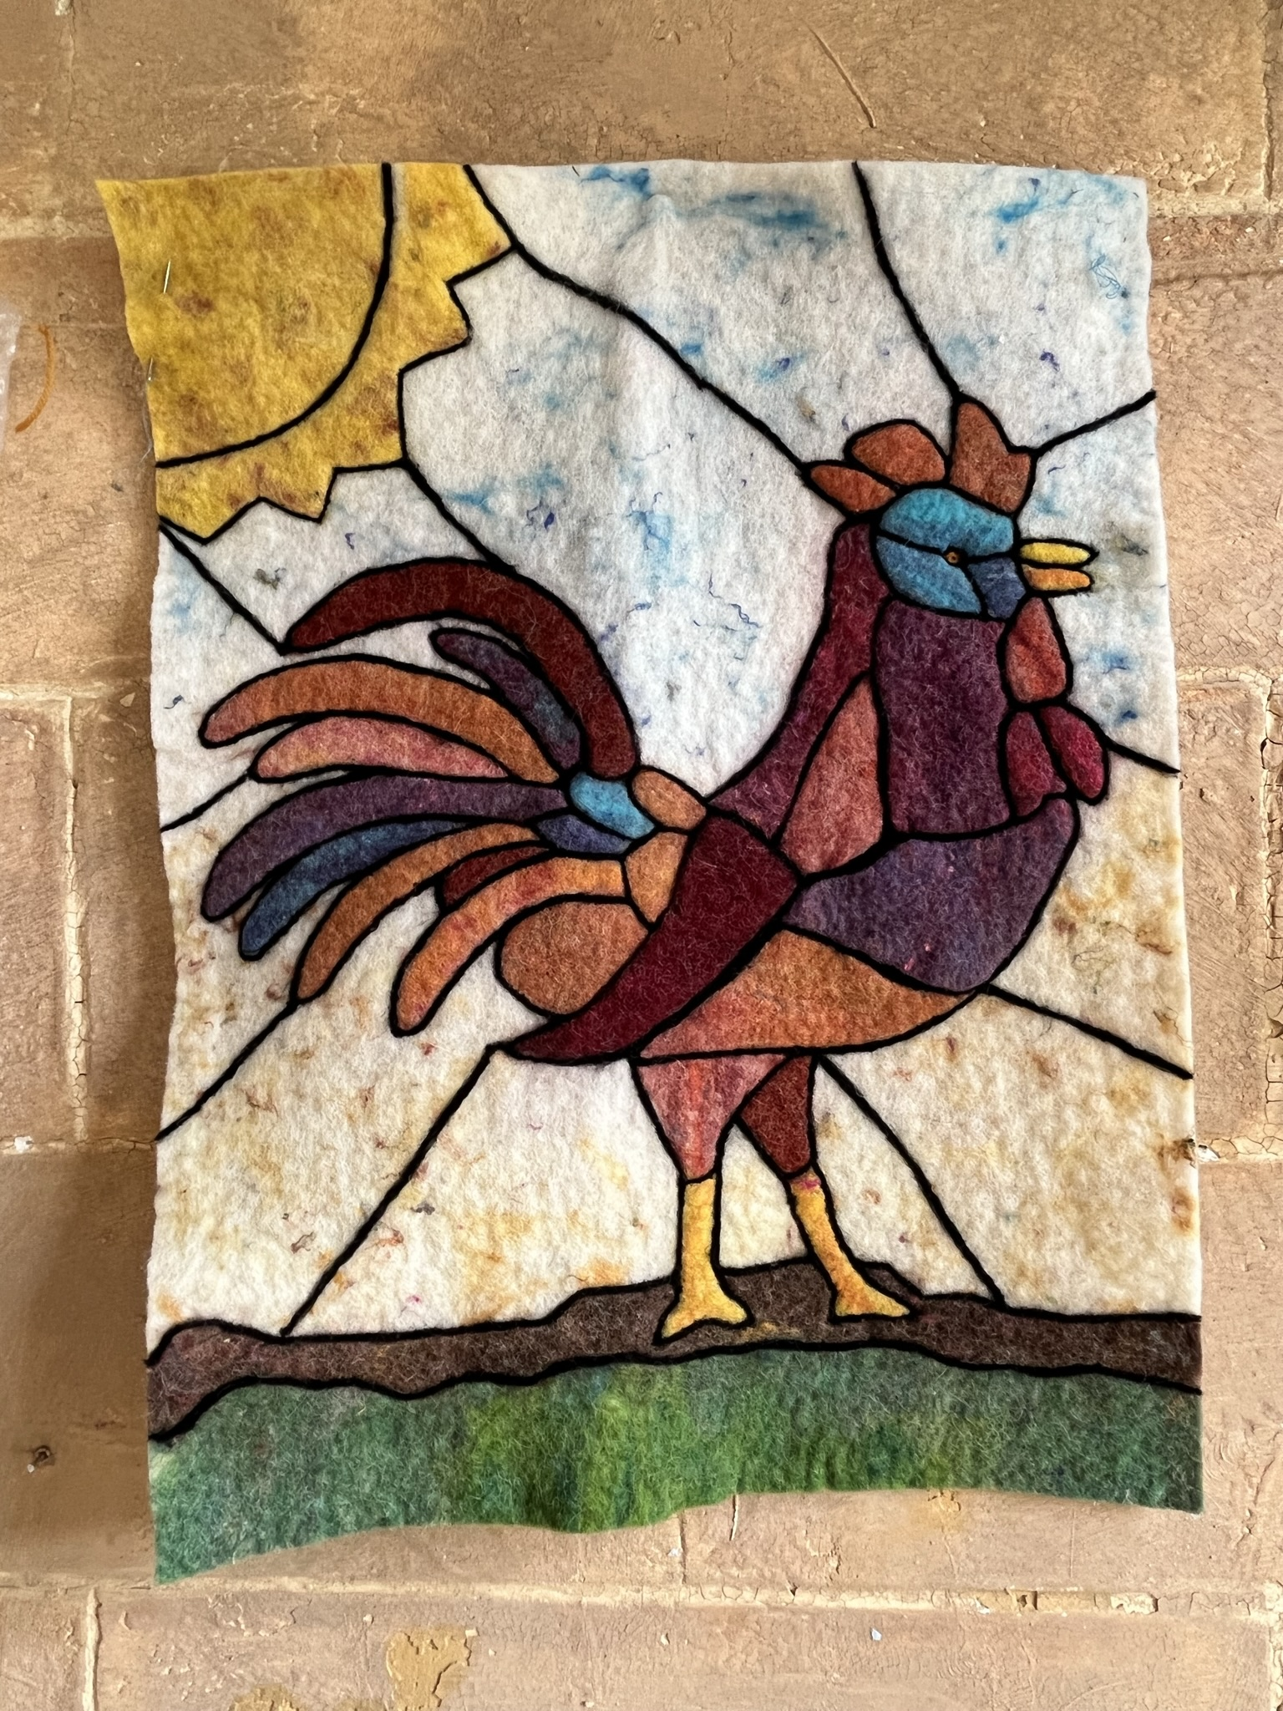
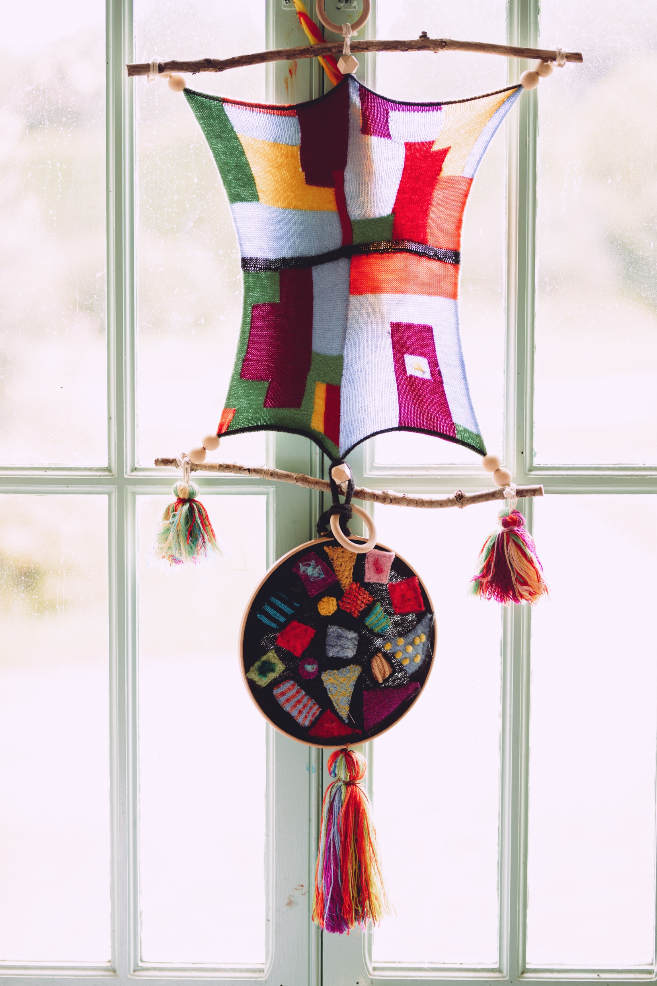
The Exhibition

Slide 22
The Community Panel

